Slide 1
Report
Analysis of Wish’s summer sales performance for summer clothes

Slide 2


Introduction
This is a comprehensive analysis of summer clothes on Wish.com. This report dives deep into the sales performance data, offering a lens into the dynamics of consumer preferences, pricing strategies, and the effectiveness of marketing efforts. Our goal is to provide the management team with actionable insights and data-driven recommendations to steer future business strategies toward enhanced sales growth and customer satisfaction.
Objective
Methodology
Significance
To unearth patterns, understand the impact of various factors on sales, and propose strategies to amplify sales success.
Utilizing Power BI for robust data visualization, we dissect sales trends, price sensitivity, consumer ratings, and promotional impacts to craft a narrative around sales performance and opportunities for growth.
Leveraging this analysis, we aim to optimize product offerings, refine marketing tactics, and improve overall profitability in the highly competitive e-commerce landscape.

Slide 3
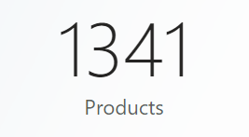
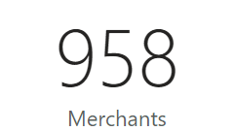
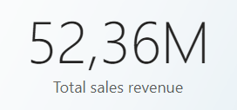
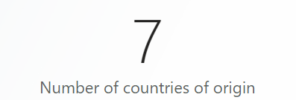
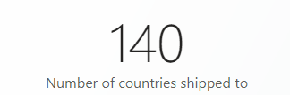
Overview (1/2)
About Wish
Wish is one of the largest e-commerce marketplaces, selling a huge variety of affordable products to consumers all over the world. Founded in 2016 in San Francisco, Wish is now active in 60+ countries. Wish provides a discovery-based shopping experience that mirrors how consumers have shopped for years in brick-and-mortar stores.

Slide 4
Overview (2/2)
Key findings
1. Retail Expansion Opportunities
- Women’s apparel leads sales, with 91.72% of products generating 96.23% of revenue, indicating a focused market strategy and high consumer demand in this segment.
Significant scope for expansion into men’s and other product categories, presenting an opportunity to diversify and broaden market reach.
2. Leveraging summer essentials
Key summer essentials like shorts, bikinis, and tanks are currently underrepresented on the website and not prominently marketed, presenting a prime opportunity for targeted ad boosts to enhance sales during the summer season.
3. Advertisement Utilization as a Revenue Booster
- Despite only 43.55% of merchants using ad boosts, these users are among our top revenue generators, indicating ad boosts' effectiveness and underutilization.
- With over half not leveraging ad boosts, there’s significant room for more merchants to adopt this strategy, potentially increasing visibility and sales.
4. Origins of products are mainly from China
- China's dominance in sales and the global reach of bikinis reflect specialized manufacturing strengths and market demands, presenting opportunities for strategic product placement and expansion.
5. Rating Count and Rating Score drive revenue
Higher product and merchant rating counts are linked to increased sales, yet with over 20% of units sold unrated, there's a key opportunity to grow sales by encouraging more customer feedback.
6. Pricing and Discounting Trends
- Product segments with high discounts drive sales, as shown by top-selling merchants who successfully employ deep discounting strategies, indicating the effectiveness of significant price reductions in attracting customers.
7. Encouraging Diverse Shopping Options
- Customers overwhelmingly choose standard shipping, indicating a preference for cost savings over speed, yet the underused express option may reveal an untapped market for faster service.

Slide 5
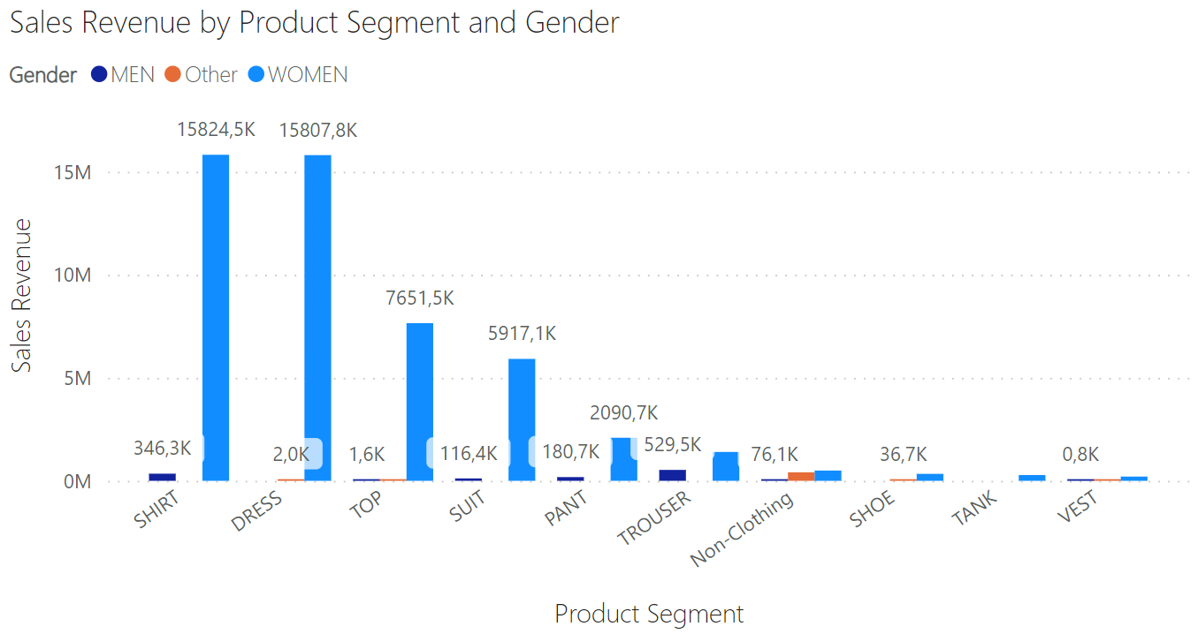
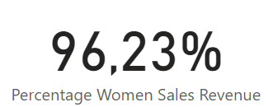
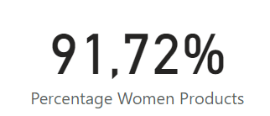
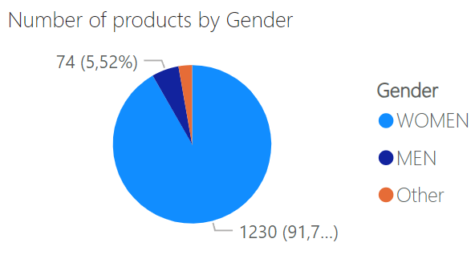
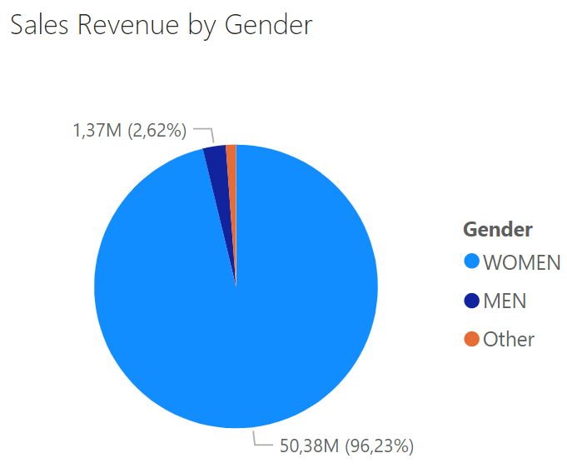
Gendered Sales Analysis
Strategic Dominance in Women's Apparel
Focused Market Strategy
Our current strategy, which emphasizes women's products, aligns well with market demand and consumer purchasing patterns, resulting in substantial revenue generation.
Product Assortment
The expansive assortment of women's products suggests a strategic decision to cater to a wide range of preferences within this segment, contributing significantly to our market share and profitability.
Opportunity for Expansion
While our success in women's products is commendable, the data presents an opportunity to explore and potentially expand our offerings in men's and other categories. This could help diversify our revenue sources and cater to a broader audience.
Inventory Optimization
The current skew towards women's products should continue to be supported by a well-managed inventory, ensuring availability of the high-demand items, particularly in the athletic, pants, and outerwear categories.
Strategic Considerations for Growth
We must consider how to leverage our strong position in women's apparel while also investigating the relatively untapped potential of the men's and 'Other' markets. Exploring these segments could involve market research, tailored marketing campaigns, and a gradual introduction of a wider product range to test the waters.

Slide 6
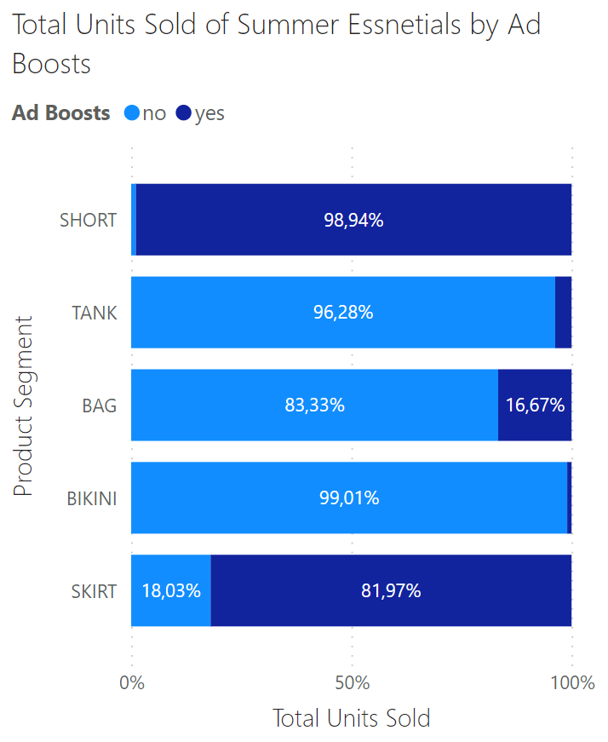
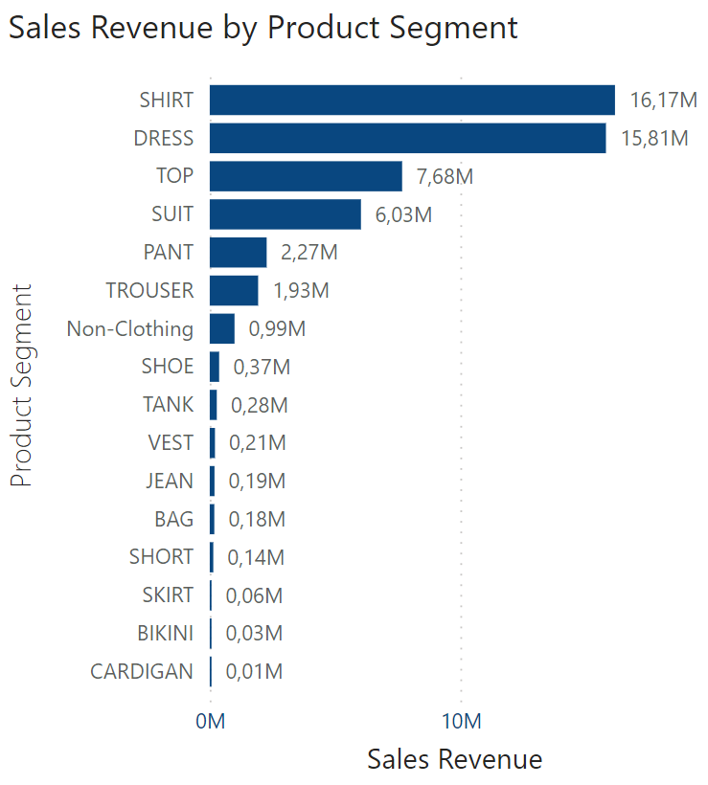
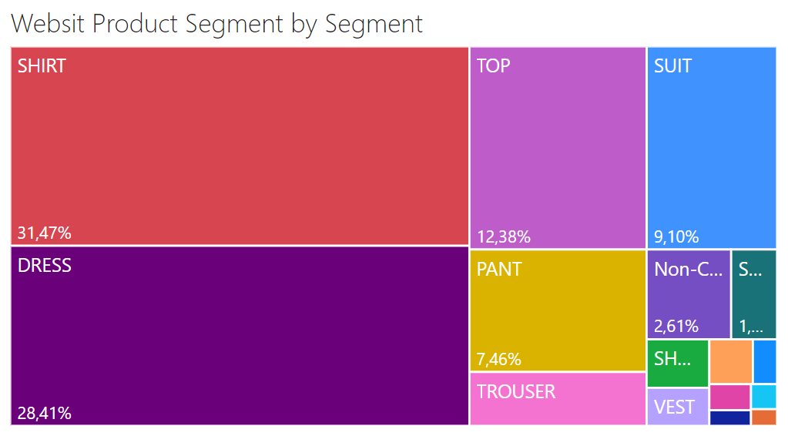
Leveraging Summer Essentials
Essentials like shorts, tanks, bags, bikinis, and skirts are experiencing notably low sales.
There are not many products from those summer segments listed on the websites. Therefore, there is an opportunity for the website to boost revenue on these products during the summer season.
These segments are not well promoted through ad boosts. Therefore, we can boost sales by directing marketing targets to these.

Slide 7
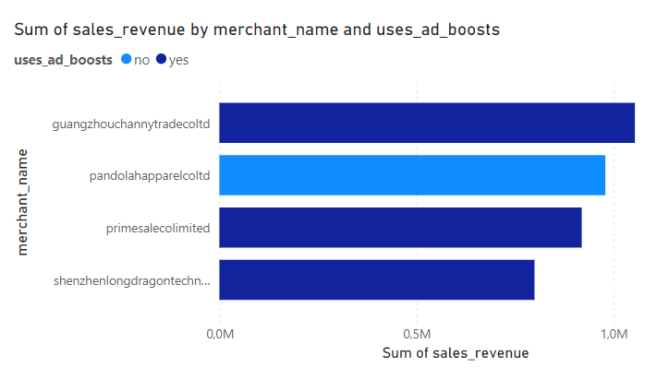
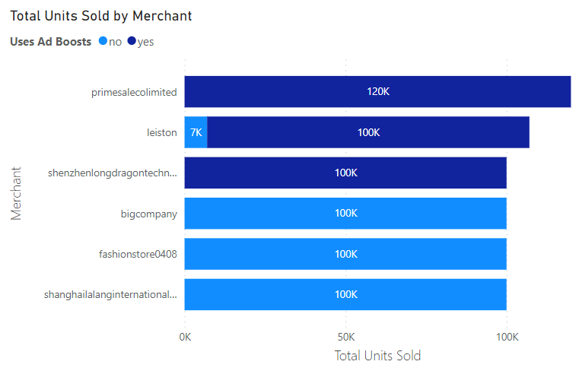
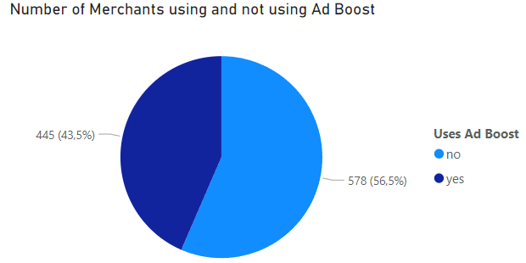
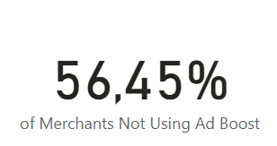
Ad Boosts’s Potential
Insight:
Our analysis reveals that ad boosts are a common thread among some of our highest revenue-generating merchants. Although only 43.55% of merchants use ad boosts, these include key value creators on our platform.
Opportunity:
With 56.45% of merchants not utilizing ad boosts, there's substantial potential for more businesses to amplify their sales and visibility. Ad boosts are not yet as widespread as they could be, presenting an opportunity to broaden their use.
Action Point:
We encourage our merchants to consider ad boosts as a strategic tool for growth. To facilitate this, we’re enhancing support for ad boost integration, ensuring ease of use and access to performance analytics.
Commitment:
Our platform is committed to empowering merchants with effective tools to succeed. Promoting ad boosts is part of our vision to foster a vibrant, competitive marketplace.

Slide 8
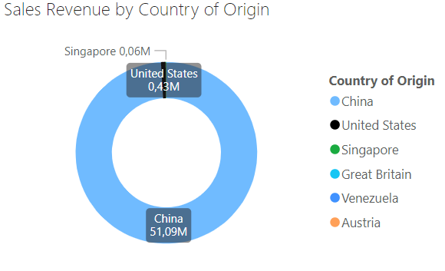
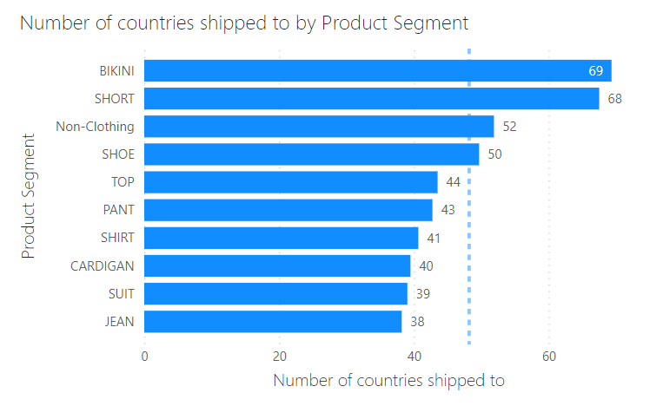
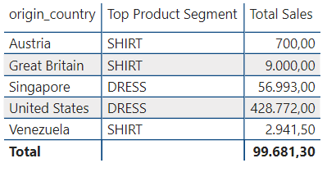
Global Apparel Insights
China
51.09M
China's Dominance in Sales Revenue
China is the leading contributor to sales revenue, which is an indicator of its substantial role in manufacturing and exporting the products sold. This could reflect the competitive pricing, extensive variety, and possibly the quality of products originating from China.
Global Distribution of Bikinis
Bikinis have the highest reach in terms of countries shipped to, suggesting global popularity. This product category appears to transcend regional market limitations, which could be due to its universal appeal in this season, potential year-round demand in various climates, and the success of international marketing strategies.
Top Product Segments by Country of Origin
Distinct manufacturing countries exhibit specialization in different product segments. The United States and Singapore are primary sources for 'Dress', whereas Austria, Great Britain, and Venezuela predominantly produce 'Shirt'. These trends may reflect the specialized production capabilities and historical textile strengths of each origin country.
China stands out as the predominant source of our product offerings, contributing to a majority of our sales revenue.
Bikini
69
Bikini is the product segment with the highest number of countries shipped to, it implies a broad international demand and acceptance of this product category

Slide 9
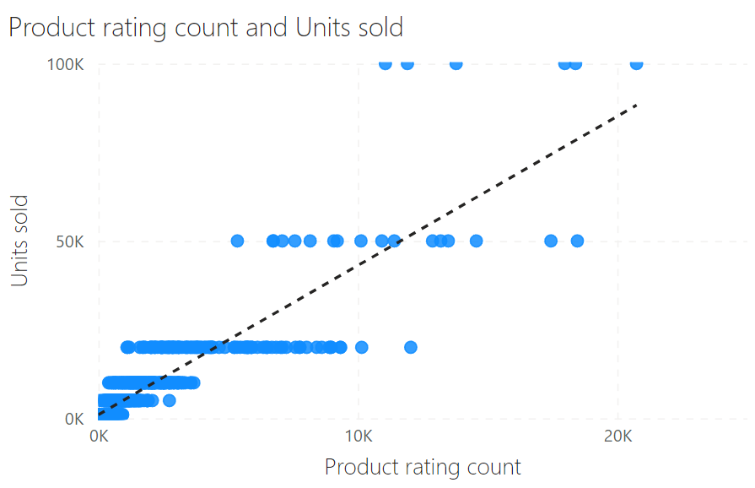
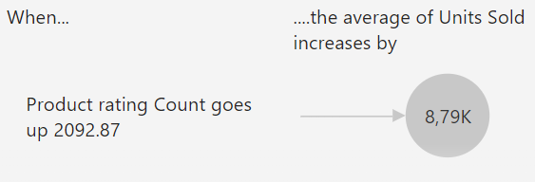
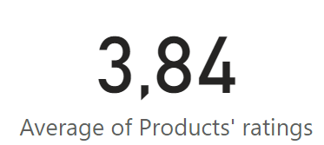
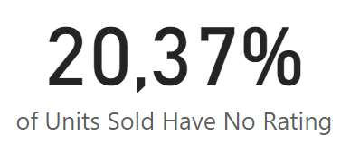
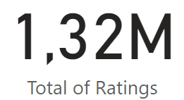
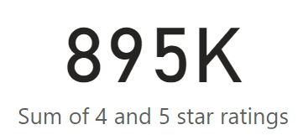
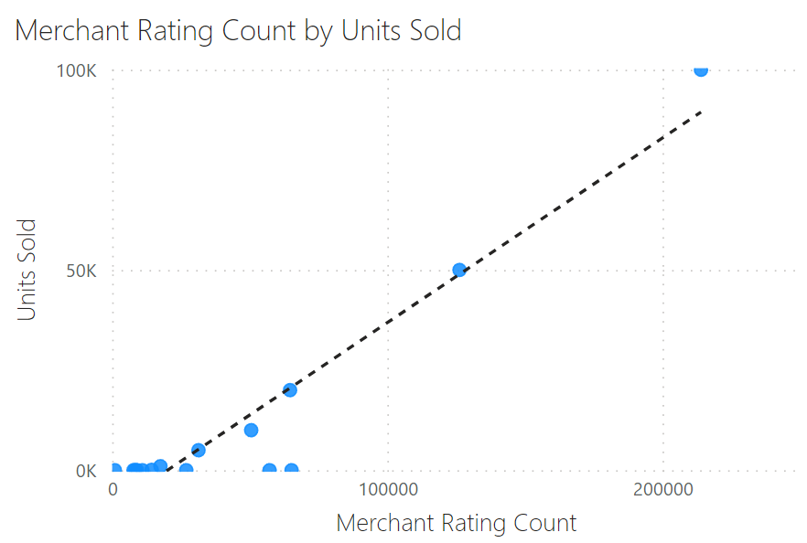
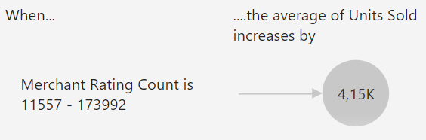
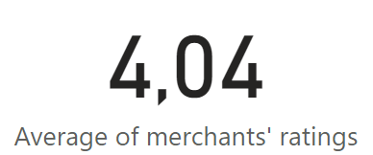
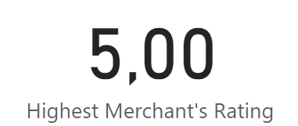
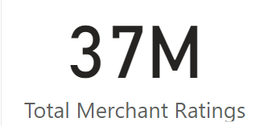
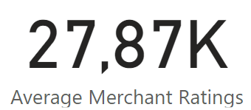
Ratings Count Impact
Product Rating Count and Units Sold
The scatter plot displays a positive correlation between the product rating count and the number of units sold, indicating that as more customers leave ratings, sales tend to increase. This suggests that products with higher engagement, in terms of customer feedback, generally have better sales performance.
Merchant Rating Count by Units Sold
Similarly, for merchants, there's a positive correlation shown between the count of ratings and the units sold. Merchants with a higher volume of ratings are associated with higher sales figures, which could imply that more established merchants with a larger customer base and more feedback tend to achieve higher sales.
Insights
Given that over 20% of units sold have not been rated, there is an opportunity to encourage more customers to leave feedback, potentially boosting future sales through increased customer confidence. Strategies to increase ratings could include follow-up emails requesting reviews or incentives for leaving feedback.

Slide 10

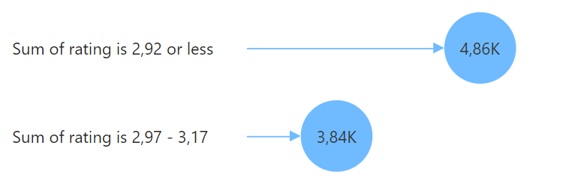
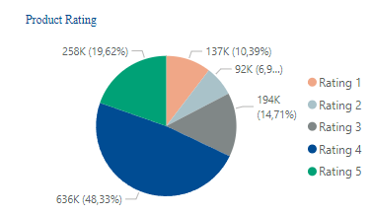
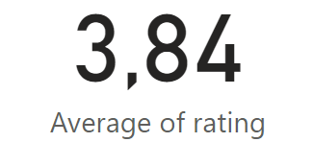
Rating’s Impacts on Sales
There exists a correlation between the product rating score and revenue, with a noticeable impact on sales. Products with a rating lower than 3.17 score tend to experience a decrease in units sold by at least 3,84K.
This trends aligns with real-life consumer behaviour in online purchases, where customers heavily rely on ratings and reviews to gauge product quality due to the inability to physically inspect times
The majority of products receive a rating of 4, accounting for 48% of ratings, while approximately 20% of products are rated 5. These figures indicate a positive perception of the products offered on the platform, reflecting favorably on customer satisfaction with product quality
On average, the products sold on this website maintain a rating
Of 3.84, surpassing the threshold of 3.17.

Slide 11
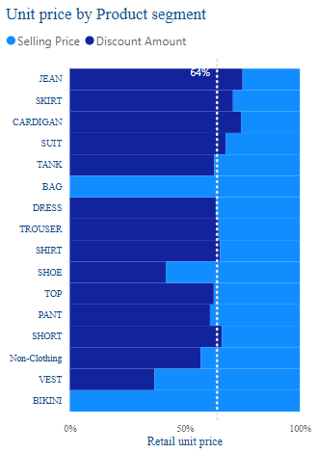
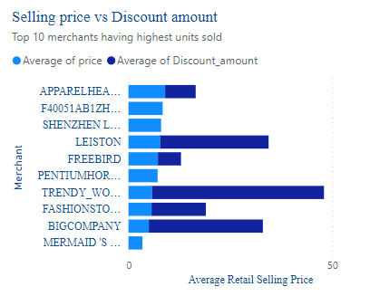
Pricing Analysis
Nearly all product segments were sold with discount rates exceeding 50%
6/10 merchants with the highest number of units sold have implemented a strategy of setting high retail prices and offering substantial discounts to incentivize customers

Slide 12
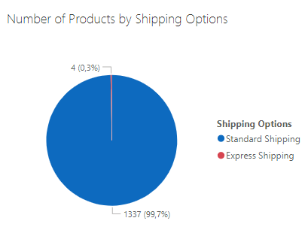
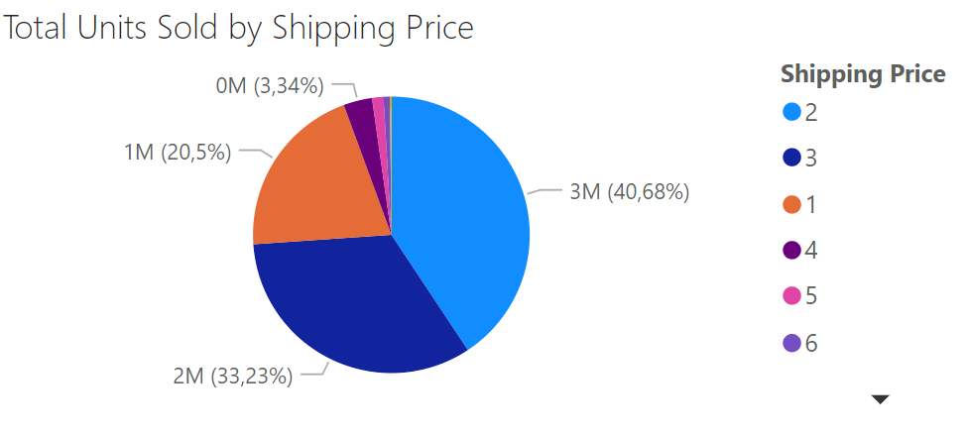
Shipping Options Analysis
Implication
Our logistics strategy is currently well-aligned with the majority of our customer base's shipping preferences. However, the underutilization of express shipping warrants a closer examination. Is it a matter of pricing, visibility, or simply a lack of demand for faster delivery times?
A recommended action is to conduct market research to understand the customer decision-making process around shipping options. Additionally, a pilot program testing reduced express shipping rates, or promotional campaigns highlighting this option, could help determine if there's an untapped market segment willing to pay for expedited delivery.
In essence, while standard shipping will remain our backbone, optimizing and promoting our express shipping could potentially unlock new customer segments and drive incremental revenue.
The provided pie chart indicates an overwhelming preference for standard shipping (99.7%) over express shipping (0.3%) among our product offerings.
Insights:
- The data strongly suggests that customers prioritize cost savings over speed of delivery. This can be attributed to the non-urgent nature of the products or the potential high cost associated with express options.
- Express shipping's negligible share implies that either customers do not value the faster service commensurately with its cost, or they are not sufficiently aware of this option.

Slide 13
Appendix
This report utilizes various constructed variables that are not included in the original dataset.
Gender | The gender of customers that the product is targeted to (Man, Woman, Others)
Product Segment | The segment of product, e.g. (Shirt, Dress, Short, etc.)
Sales Revenue | The total sales revenue of the product by multiplying price by units sold.
Discount Amount | Retail Price - Price

